Slide 1
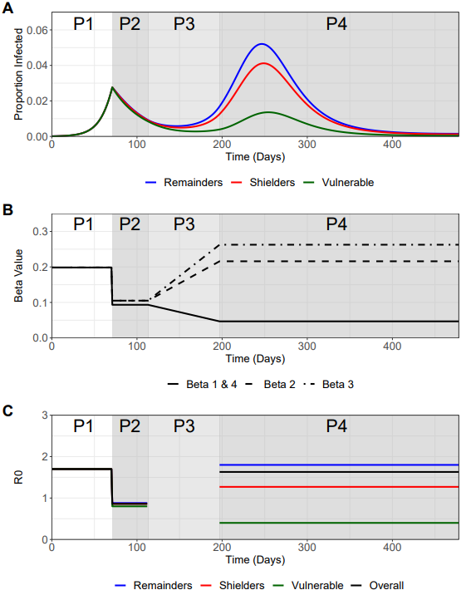
Figure 2A+B
BASELINE PLOTS
Will include R0 plots soon
B1 | B1 | B4 | B4 | B4
B1 | B1 | B2 | B2 | B2
B4 | B2 | B3 | B3 | B3
B4 | B2 | B3 | B3 | B3
B4 | B2 | B3 | B3 | B3
Beta1 = Beta4

Slide 2
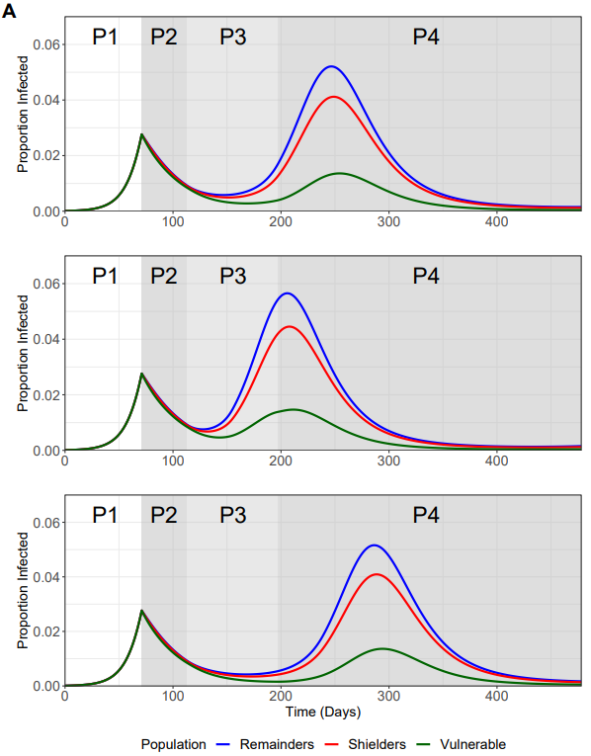
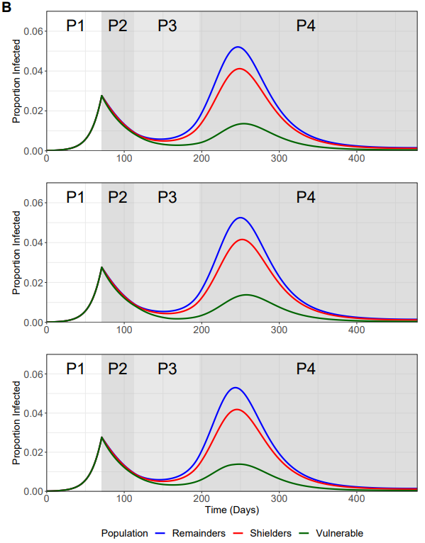
Figure 3A+B
Include the text in the figure description – not part of figure!
Baseline
Baseline
Rampdown
Beta1/4 – 12 weeks
Rampup
Beta3/4 – 12 weeks
Rampdown
Beta1/4 – 12 weeks
Rampup
Beta3/4 – 12 weeks
Rampdown
Beta1/4 – 12 weeks
Rampup
Beta3/4 – 6 weeks
Rampdown
Beta1/4 – 6 weeks
Rampup
Beta3/4 – 12 weeks
Rampdown
Beta1/4 – 12 weeks
Rampup
Beta3/4 – 18 weeks
Rampdown
Beta1/4 – 18 weeks
Rampup
Beta3/4 – 12 weeks

Slide 3
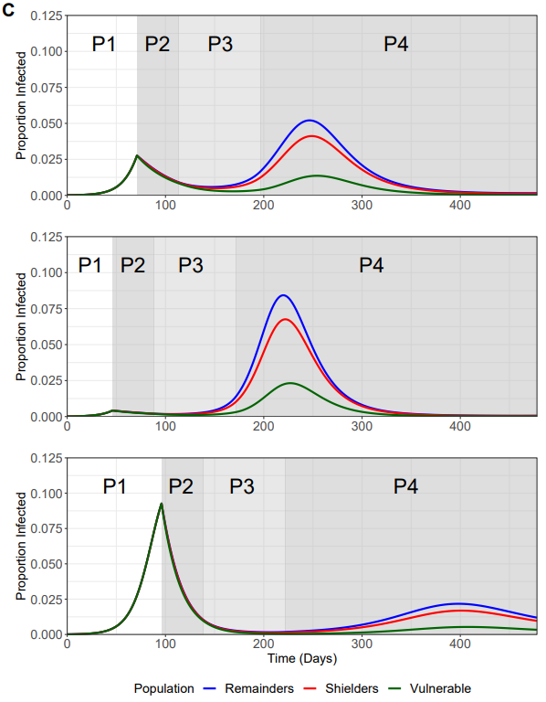
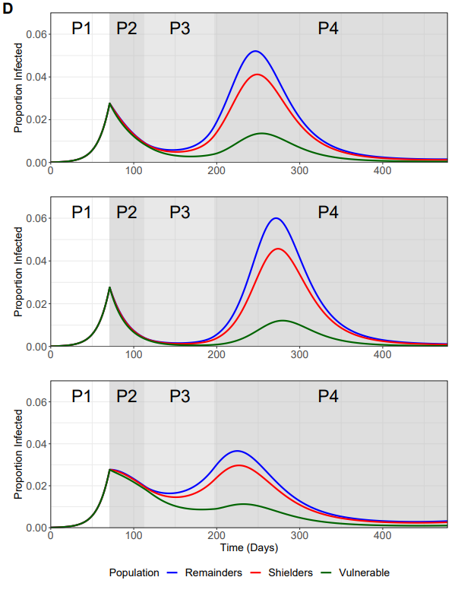
A
B
A
B

Slide 4
Figure 3C+D
Include the text in the figure description – not part of figure!
Baseline
Baseline
Trigger Point
I(t) = 0.0277
Day 71
Phase 2
Beta_1/4 = 0.8
Beta_3/4 = 0.9
Trigger Point
I(t) = 0.0042
Day 46
Phase 2
Beta_1/4 = 0.6
Beta_3/4 = 0.7
Trigger Point
I(t) = 0.093
Day 96
Phase 2
Beta_1/4 = 1.0
Beta_3/4 = 1.1

Slide 5
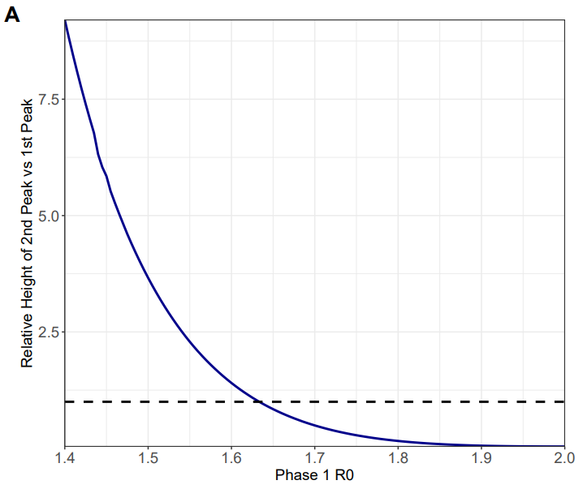
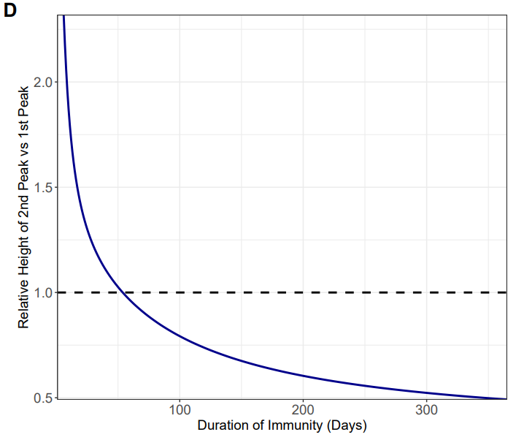
Figure 4A+D
Include the text in the figure description – not part of figure!
A
Dotted line represents the point at which the height of the 2nd peak = the height of the 1st peak
Minimum Duration of Immunity before Vulnerable I(t) 2nd Peak is greater than 1st Peak:
54 Days or ζ = 1/54
B

